Slide 1
Asymptotic Notations
Text
Chapters 3

Slide 2
Asymptotic Notation
What does “the order of” mean
Big O, Ω, and Θ notations
Properties of asymptotic notation
Limit rule

Slide 3
A notation for “the order of”
We’d like to measure the efficiency of an algorithm
  Determine mathematically the resources needed
There is no such a computer which we can refer to as a standard to measure computing time
We introduce “asymptotic” notation
  An asymptotically superior algorithm is often preferable even on instances of moderate size

Slide 4
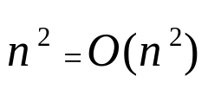
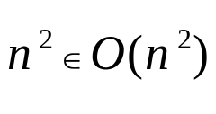
Definition of big O
Typically used for asymptotic upper bound
Attention
  O(f(n)) is a set of functions
Pitfall
  Traditionally we say as used in our text book
  It really means

Slide 5
A graphical view of asymptotic definition
cg(n)
f(n)
0
n₀
n

Slide 6




Example
Prove that following statements

Slide 7

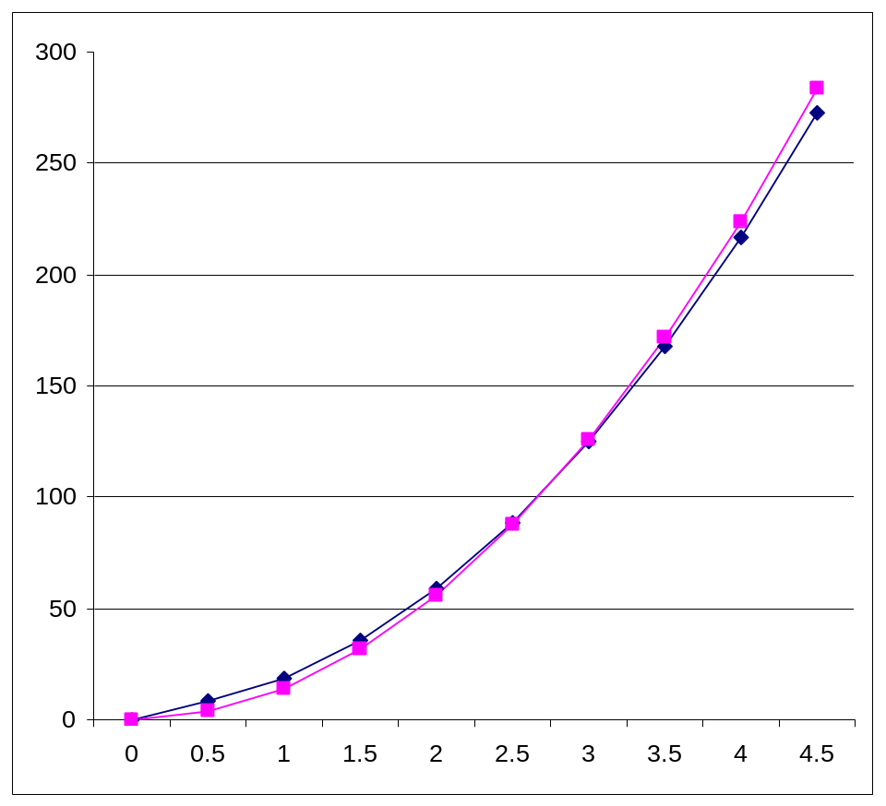


What are c and n₀?

Slide 8
Several notations
Logarithm time O(log n)
Linear time O(n)
Quadratic time O(n²)
Cubic time O(n³)
Exponential time O(c^{n}), c>1
Order of growth

Slide 9
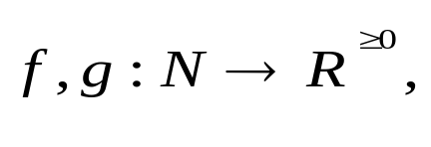
The Maximum rule
Let
then
Proof
  the key is max(f(n),g(n)) <= f(n)+g(n) <= 2*max(f(n),g(n))
Examples
  O(12n³-5n+nlogn+36)
The maximum rule let us ignore lower-order terms

Slide 10
Example
True or false
  ? 5 = O(log n)
  ? log n = O(5)
  ? n = O(n^{0.6}logn)
  ? n^{0.6}logn = O(n)
  ? n⁸ = O((n²-3n+5)⁴)

Slide 11
Definition of Ω
Ω is typically used to describe asymptotic lower bound
  For example, insertion sort take time in Ω(n)
Ω for algorithm complexity
  We use it to give the lower bounds on the intrinsic difficulty of solving problems
  Example, any comparison-based sorting algorithm takes time Ω(nlogn)

Slide 12
Example of Ω(n²)
n²
n²+n
n²-n
n^{2.0001}
n²log n
2^{n}

Slide 13
The Θ notation
Definition:
Used to describe asymptotically tight bound
Example: selection sort take time in Θ(n²)
Equivalent to:

Slide 14

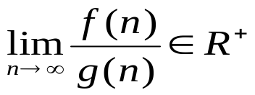

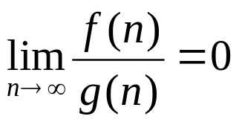


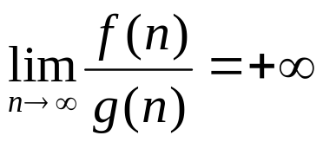


The Limit Rule
Let then
If then
If then but
If then but

Slide 15
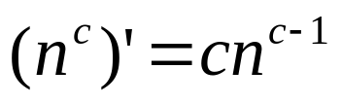
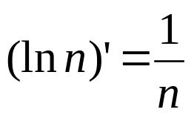
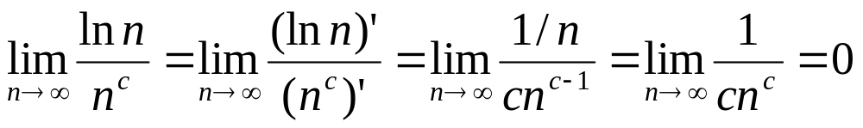
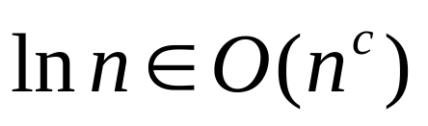
Example
(ln n means log_{e}n, the text use log)
When c>0
for any c>0

Slide 16
Semantics of big-O and Ω
When we say an algorithm takes worst-case time
t(n) = O(f(n)), then there exist a real constant c such that c*f(n) is an upper bound for any instances of size of sufficiently large n
When we say an algorithm takes worst-case time
t(n) = Ω(f(n)), then there exist a real constant d such that there exists at least one instance of size n whose execution time >= d*f(n), for any sufficiently large n
Example
  Is it possible an algorithm takes worst-case time O(n) and Ω(nlog n)?

Slide 17
Practice Problems
True or false
  The algorithm takes time in O(n²)
  The algorithm takes time in Ω(n²)
  The algorithm takes time in O(n³)
  The algorithm takes time in Ω(n³)
  The algorithm takes time in Θ(n³)
  The algorithm takes time in Θ(n²)
  The algorithm takes worst case time in O(n³)
  The algorithm takes worst case time in Ω(n³)
  The algorithm takes worst case time in Θ(n³)
  The algorithm takes best case time in Ω(n³)
anAlgorithm( int n)
{
// if (x) is an elementary
// operation
if (x) {
some work done
by n² elementary
operations;
} else {
some work done
by n³ elementary
operations;
}
}

Slide 18
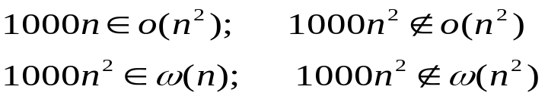
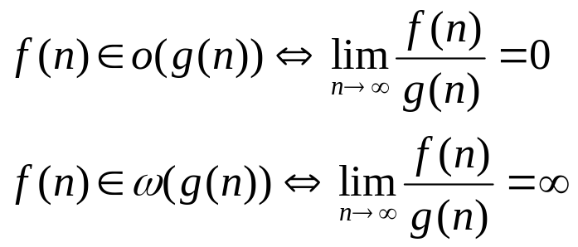
Definition of o and ω
Definition
Denote upper/lower bounds that are not asymptotically tight
Example
Properties

Slide 19
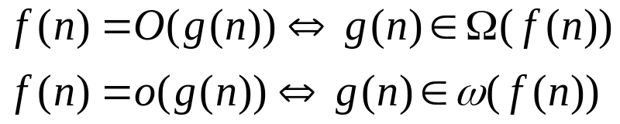
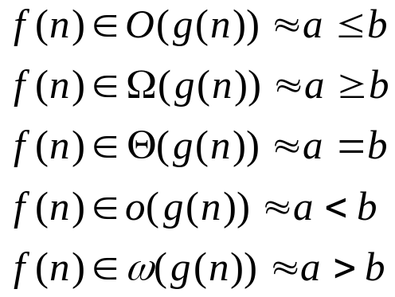
Relational Properties
Transitivity: O, o, Ω, ω,Ө
Reflexivity: O, Ω, Ө
Symmetry:
Transpose symmetry (Duality)
Analogy

